Slide 1
FORM
DESIGN
FUNCTION

Slide 2

Sea of
Mysteries
Shoreline of Wonder
Island of
Knowledge

Slide 3
RELATIVE
POSITIONS

Slide 4



Sea of
Mysteries
Data Visualization
Shoreline of Wonder
Designer
User
Island of
Knowledge

Slide 5
Sea of
Mysteries
Data Visualization
Shoreline of Wonder
User
Designer
Island of
Knowledge

Slide 6
Graphical
Perception
Mental
imagery
Data Visualization
DECODING
ENCODING
User
Designer

Slide 7
“The abundance of evidence that mental imagery can be depictive [i.e., picture-like] while still involving semantic information [i.e., language-like] is now overwhelming.”
— Joel Pearson, The human imagination: the cognitive neuroscience of visual mental imagery.
Nature Reviews | 2019 | https://doi.org/10.1038/ s41583-019-0202-9

Slide 8
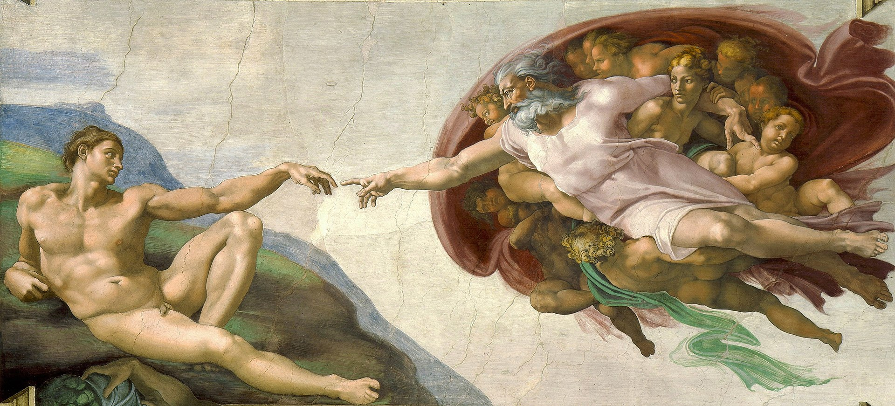
By Michelangelo - See below., Public Domain, https://commons.wikimedia.org/w/index.php?curid=71427942
Notes:
So, where do we start? Perhaps from the very beginning. How do you start creating a data visualization (in its broadest sense): a conceptual figure, a chart, etc.?

Slide 9

Notes:
Creative friction

Slide 10
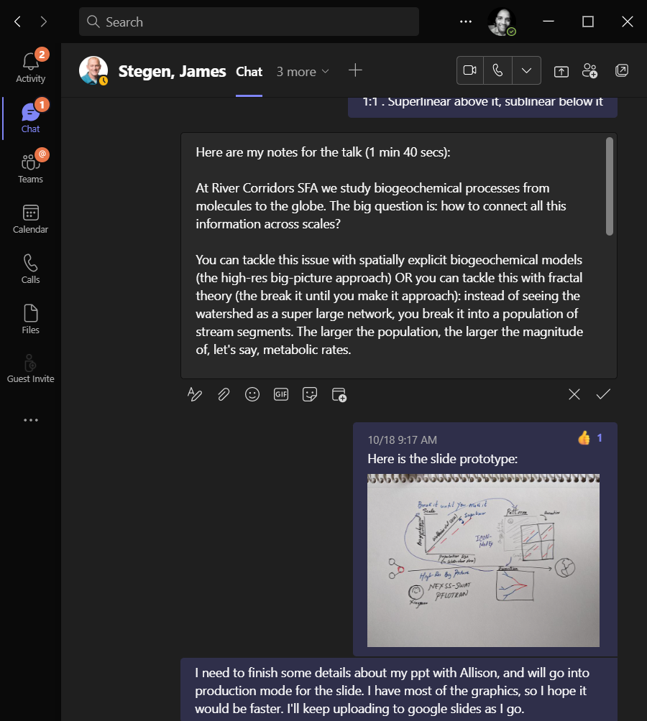

Slide 11
TEXT FACE – Barlow
COLOR PALETTE HEX CODES
Darkest - #0E313A
Dark - #234F5B
Medium - #3A707F
Light - #9ECCC6
Lightest - #CFE5E2
Pink - #FF9E80
Red - #F75848

Slide 12

Sea of
Mysteries
Mental imagery
Graphical Perception
DATA
VISUALIZATION
ENCODING
DECODING
Island of
Knowledge

Slide 13

Sea of
Mysteries
Mental imagery
Graphical Perception
DATA
VISUALIZATION
ENCODING
DECODING
Designer
User
Island of
Knowledge

Slide 14
Sea of
Mysteries
Mental imagery
Graphical Perception
DATA
VISUALIZATION
ENCODING
DECODING
Designer
User
Island of
Knowledge

Slide 15


The Sea of Mysteries
DESIGNER
USER
Mental imagery
Graphical Perception
ENCODING
DATA
VISUALIZATION
DECODING
The Shoreline
of Wonder
The Island of Knowledge

Slide 16

Sea of Mysteries
Designer
User
Data Visualization
Island of Knowledge
The Shoreline
of Wonder

Slide 17
The Sea of Mysteries
DESIGNER
USER
DATA
VISUALIZATION
The
Shoreline
of
Wonder
The Island of Knowledge

Slide 18
Sea of
Mysteries
Data Visualization
Shoreline of Wonder
Designer
User
Island of
Knowledge

Slide 19
Sea of
Mysteries
Designer
User
Island of
Knowledge

Slide 20
“I found that the great majority of the men of science […] protested that mental imagery was unknown to them […] they had no more notion of its true nature than a color-blind man who has not discerned his defect...”
— Francis Galton, Statistics of Mental Imagery.
Mind: A Quarterly Review of Psychology and Philosophy | 1880 | https://psychclassics.yorku.ca/Galton/imagery.htm

